Slide 1

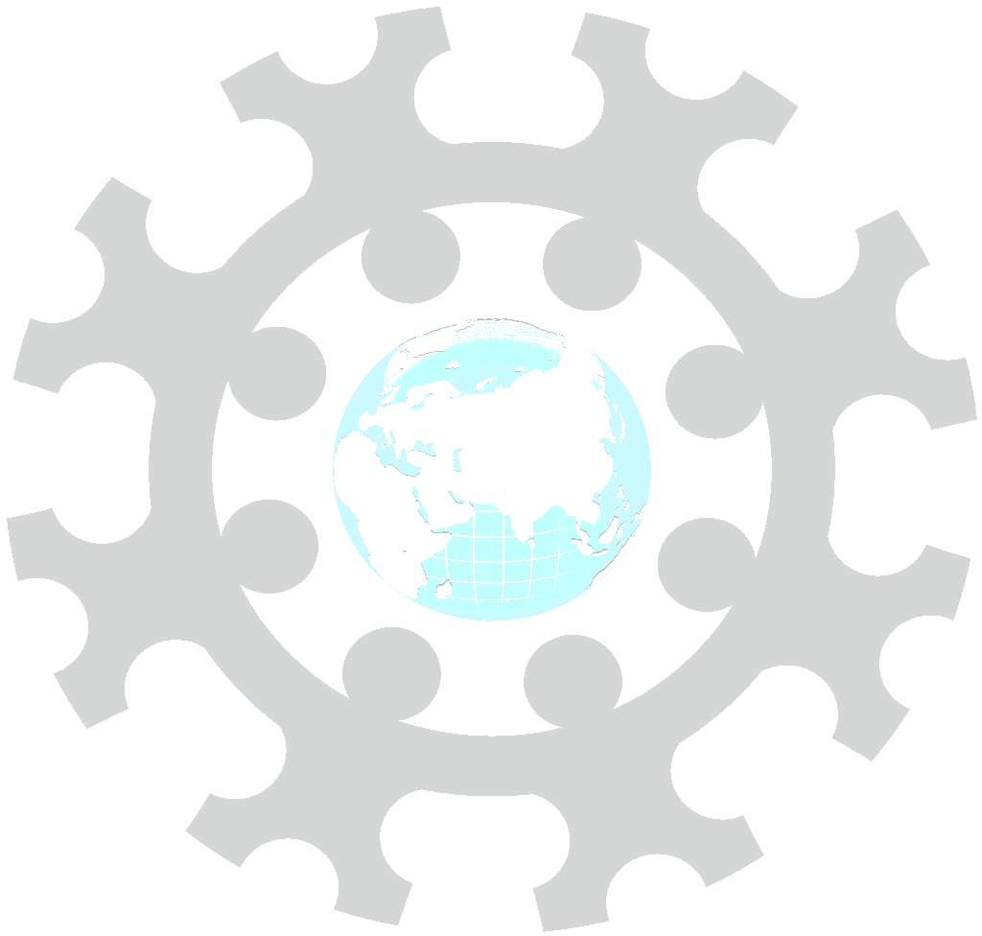
INSTITUTE : UIE
DEPARTMENT : CSE
Bachelor of Engineering (Computer Science & Engineering)
WEB AND MOBILE SECURITY (Professional Elective-I)
(20CST/IT-333)
TOPIC OF PRESENTATION:
Web application management attacks against remote server management
DISCOVER . LEARN . EMPOWER

Slide 2
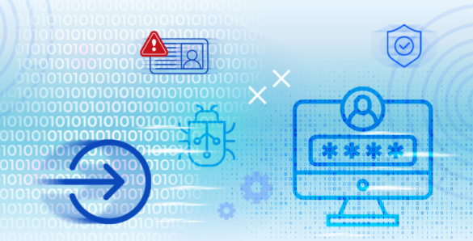
Lecture Objectives
In this lecture, we will discuss:
Web application management attacks against remote server management

Slide 3
SSRF
Server-side request forgery (SSRF) is an attack that allows attackers to send malicious requests to other systems via a vulnerable web server. Listed in the OWASP Top 10 as a major application security risk, SSRF vulnerabilities can lead to information exposure and open the way for far more dangerous attacks. If attackers can control the destination of server-side requests, this opens up a whole array of offensive activities, potentially allowing them to:
Abuse the trust relationship between the vulnerable server and other systems
Bypass IP whitelisting
Bypass host-based authentication services
Read web resources and other useful assets that are not accessible to the public, for instance metadata APIs in AWS environments or trace.axd in ASP.NET
Perform port scans on the internal network that the server is connected to
Read files from the web server
View status pages and interact with APIs as the web server
Retrieve sensitive information such as the IP address of a web server running behind a reverse proxy
SSRF i

Slide 4
Common remote access attacks
An attacker could breach a system via remote access by:
Scanning the Internet for vulnerable IP addresses.
Running a password-cracking tool.
Simulating a remote access session with cracked username and password information.

Slide 5
security to avoid remote access attacks
The best way to prevent remote access attacks is to discontinue remote access. But that is not always a realistic option. Alternatively, by taking simple steps and encouraging a multi-layered approach to security, businesses can secure their organization against a potentially devastating breach.
Restrict access to sensitive data
By identifying sensitive systems and isolating them on their own network zone, businesses can control what type of access is allowed into these zones and restrict remote access attacks to only allow two-factor authentication.
Change your default username
To make it more difficult for hackers to guess your username, don't use the username for the other non-sensitive systems or in any public forums. Instead of using common terms, use out of this world names or combination of characters, symbols, and numbers that don't fit the standard username will help prevent remote access attacks.

Slide 6
Do not enable Guest accounts
Guest and default accounts allow anonymous computer and system access. Disabling the guest accounts on each computer protects against unauthorized users. Disabling or changing default account makes it difficult for attackers to launch remote access attacks. Many systems and applications come installed with default or guest accounts and passwords that should be changed to make it more difficult for attackers to enter systems.
Protect systems against known malware
A good Anti-virus, like the Comodo Antivirus, is updated on a regular basis to detect against known malware. Maintaining an up-to-date antimalware program that scans systems on a regular basis will prevent known remote access attacks.
Lockout hackers
Set your computer to lockout a user after six failed login attempts. Requiring an administrator to manually unlock accounts will prevent attackers from guessing a few passwords and coming back later to try again. In this way, it will difficult for bad guys to launch remote access attacks to your system.
Use two-factor authentication
Using two-factor authentication can help prevent major remote access attacks on your system.
Implement vulnerability scanning
Vulnerability scans are automated tests that passively test systems and networks to identify known weaknesses. These scans generate reports that provide specific data about weaknesses specific to the entities systems and networks. These reports allow entities to find and fix vulnerabilities in a timely manner.

Slide 7
What technologies are used for Secure Remote Access?
Secure remote access is not a single technology, but rather a collection of technologies that together provide the security that organizations need when users are working from home or other remote locations. They include:
Endpoint Security – This includes software such as antivirus for endpoint machines as well as policies that define how remote devices are to be used in the organization’s systems. This can include patch management and the prevention of downloading or caching business-critical information to remote devices.
Virtual Private Network (VPN) – VPNs are extremely popular for remote access, since they allow remote users connected via insecure remote Wi-Fi (Starbucks, bookshops) to connect to a private network through an encrypted tunnel.
Zero Trust Network Access (ZTNA) – As the name implies, ZTNA solutions make no assumptions about the security of a connection and require re-authentication before every transaction. This offers higher levels of security for the organization’s data and applications.
Network access control (NAC) – Network access is managed via a combination of tools such as two factor authentication (2FA), endpoint security tools, and policy education and enforcement.

Slide 8
References:
Books:
Web Design With HTML, CSS, JavaScript and jQuery Set, 1st Edition, by Jon Duckett.
Hacking Exposed Web Applications, 3rd edition, Joel Scambray, Vincent Liu, Caleb Sima, Released October 2010, Publisher(s): McGraw-Hill
Video Lectures :
https://www.youtube.com/watch?v=9ZokuRHo-eY
https://getvoip.com/blog/2020/05/06/voip-security/
Reference Links:
https://cheatsheetseries.owasp.org/cheatsheets/Cross_Site_Scripting_Prevention_Cheat_Sheet.html
https://portswigger.net/web-security/cross-site-scripting
https://www.ibm.com/garage/method/practices/code/protect-from-cross-site-scripting/

Slide 9
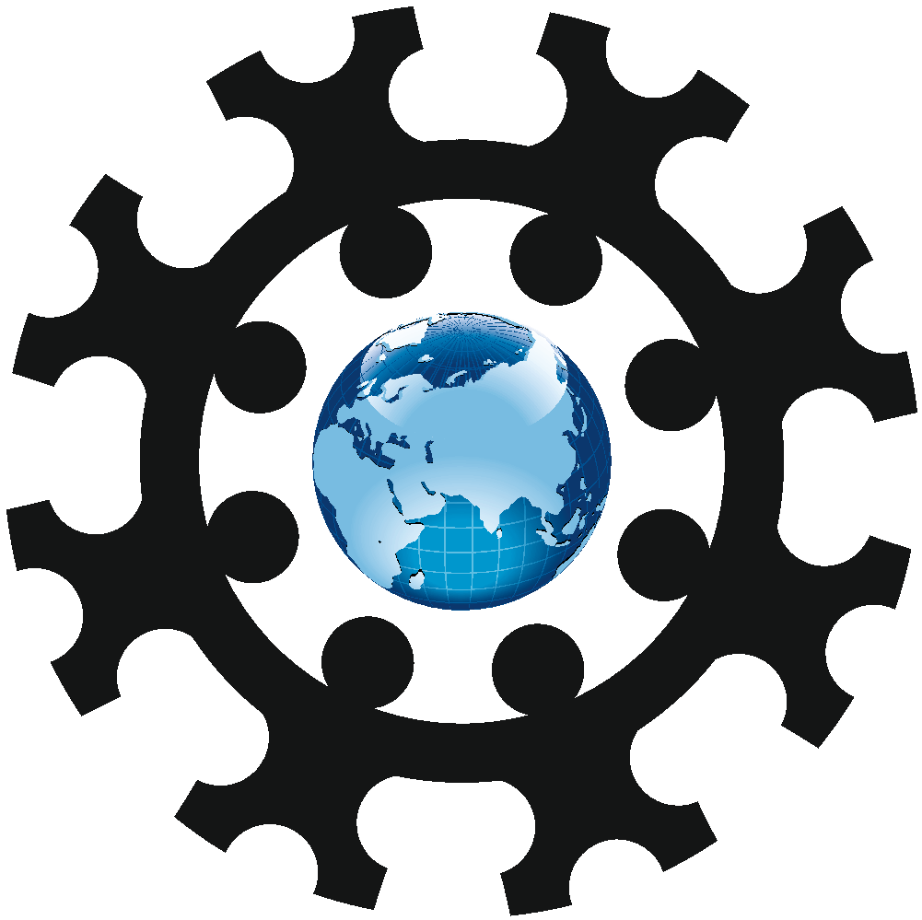
THANK YOU

